Slide 1


Managing your code: quietly introducing Git - a friend for life
Thanks to all contributors:
Alison Pamment, Sam Pepler, Ag Stephens, Stephen Pascoe, Kevin Marsh, Anabelle Guillory, Graham Parton, Esther Conway, Eduardo Damasio Da Costa, Wendy Garland, Alan Iwi and Matt Pritchard.

Slide 2
Overview
REMINDER SLIDE SET:
Remember you can:
Add a file/dir
Commit (to local)
Push (to remote)
Remove a file
Look at a diff

Slide 3
Managing code in the olden days
Create “working_dir”...add some code
Write some outputs...change the code
Publish a paper...change the code
Copy “working_dir” to “working_dir2”
Change the code
Copy a version to a CD
...now which version is current? Is it “working_dir” or “working_dir2”? And which one relates to that paper?

Slide 4
But those days are gone!
Scientists are typically required to publish data and code (by their funders/institutions).
Collaboration between scientists requires data-sharing; this implicitly relies on code-sharing.
There are tools that make it easy to record our changes, document our workflow and “fix” releases of our code at important steps along the way.

Slide 5
So, working on the premise that we accept that we need to know about, and use, version control…

Slide 6
ADD LOGOS HERE
On this course: we will use Git and GitHub
Notes:
There are lots of different version control systems. We recommend using Git as the tool, and that you use GitHub as the free on-line service to manage your repository.

Slide 7
Introducing Git
There are many different Version Control tools:
SVN (Subversion) is very popular and (relatively) easy to grasp; eclipsed by…
Git, which is also:
More useful for collaboration
Distributed and fast
Very well supported in terms of tooling
Has free repository hosts on the web (GitHub, BitBucket etc.,).
Notes:
Talk through slide

Slide 8
More about Git
Git is a distributed Version Control System (VCS):
you store a complete copy of a repository within your working copy.
this means you can work offline:
there is no default ‘central’ server - if you want one, you (and your team) just nominate where it is - typically GitHub!
Notes:
Talk through slide

Slide 9
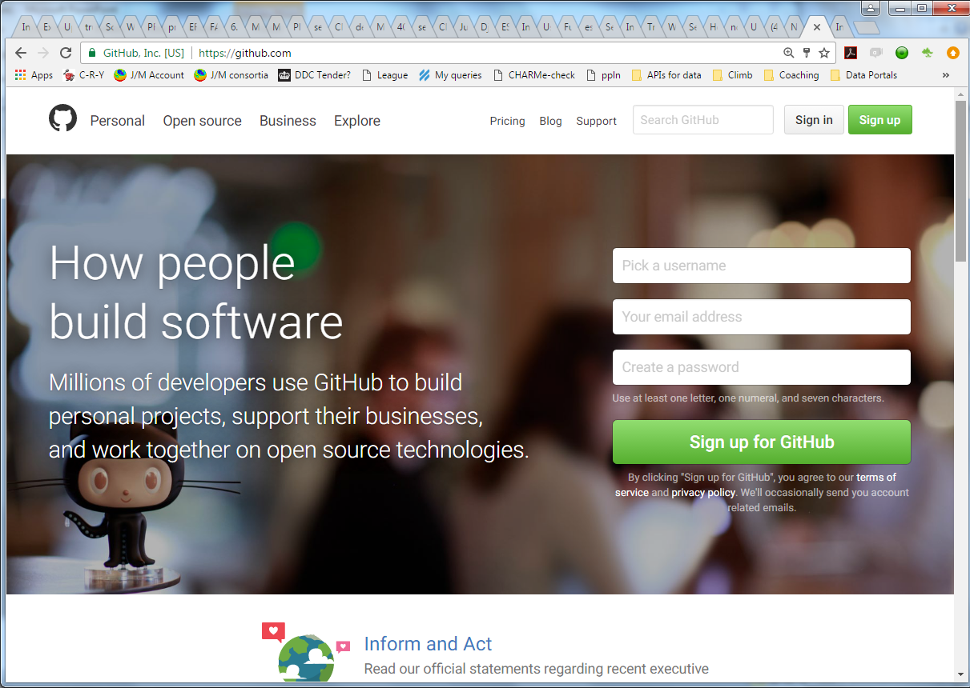
Introducing GitHub
https://github.com
Notes:
GitHub is a web site and eco-system of web tools that make code development easier.

Slide 10
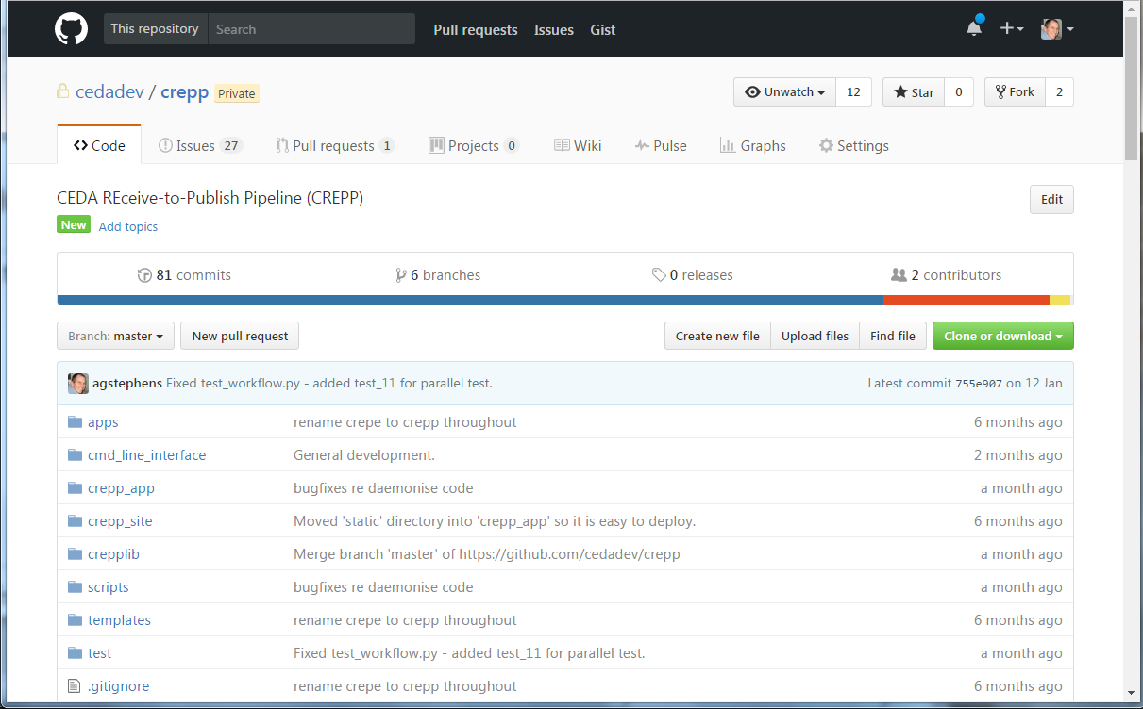
GitHub: repositories (public or private)
Notes:
You can create public or private code (and small data) repositories. A full version of your code is stored on the GitHub servers and can be shared with anyone you like.

Slide 11
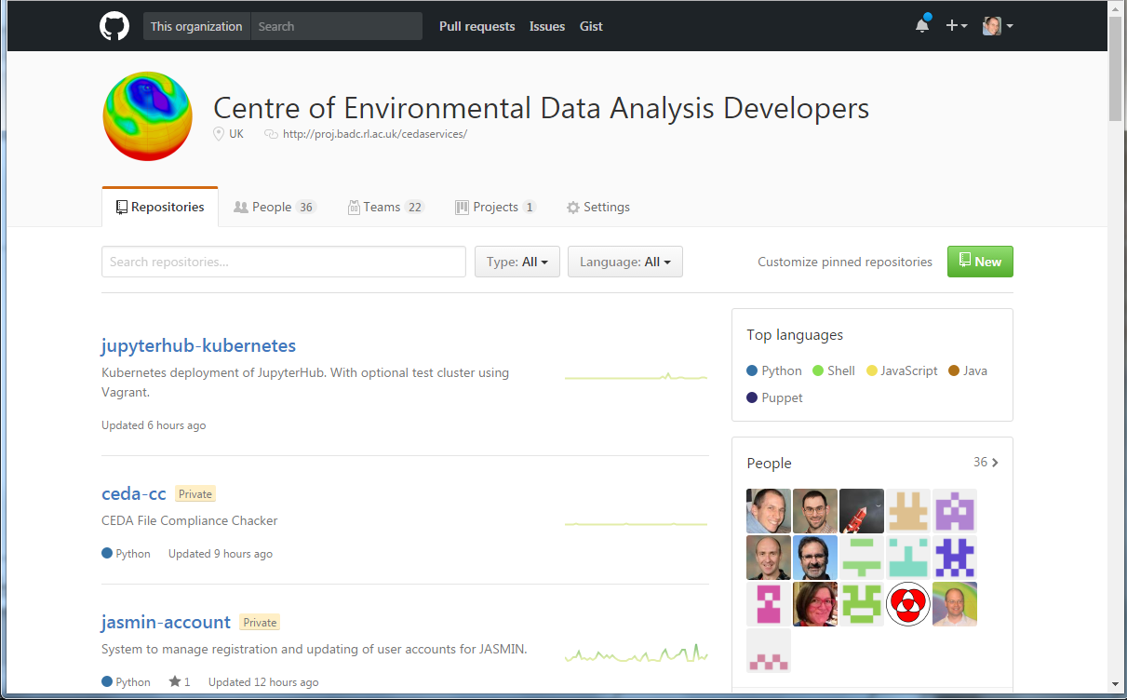
GitHub: organisations
Notes:
You can create organisations that group together a set of collaborators that work on projects collectively.

Slide 12
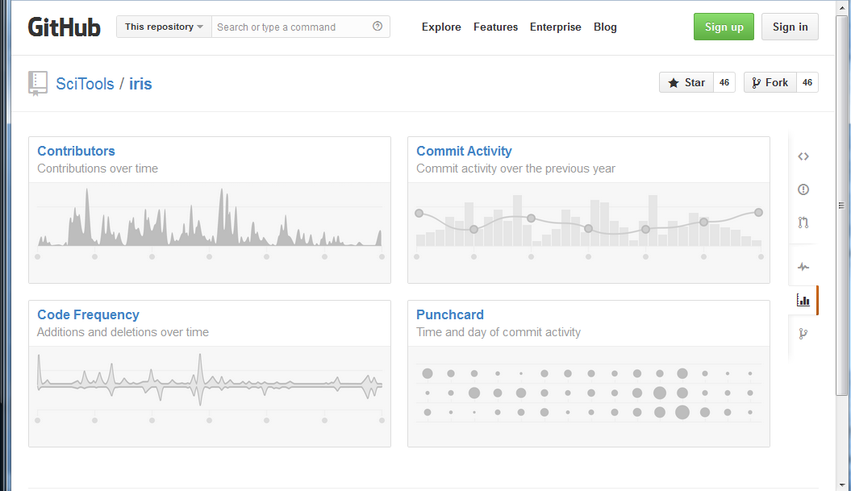
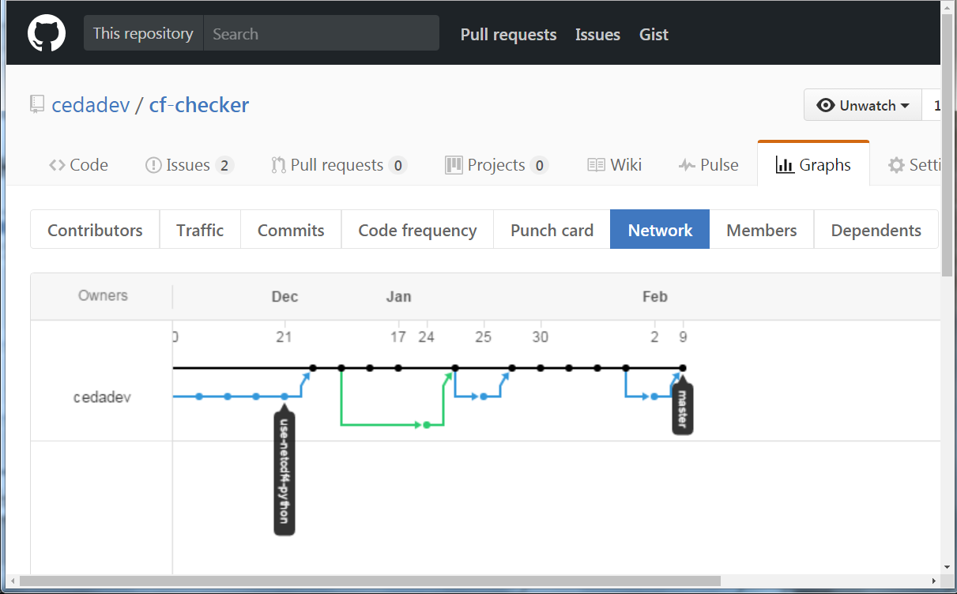
GitHub: collaboration (branch/fork)
Notes:
Multiple people can easily collaborate on code with tried-and-testing tools for branching and merging work in different strands.

Slide 13
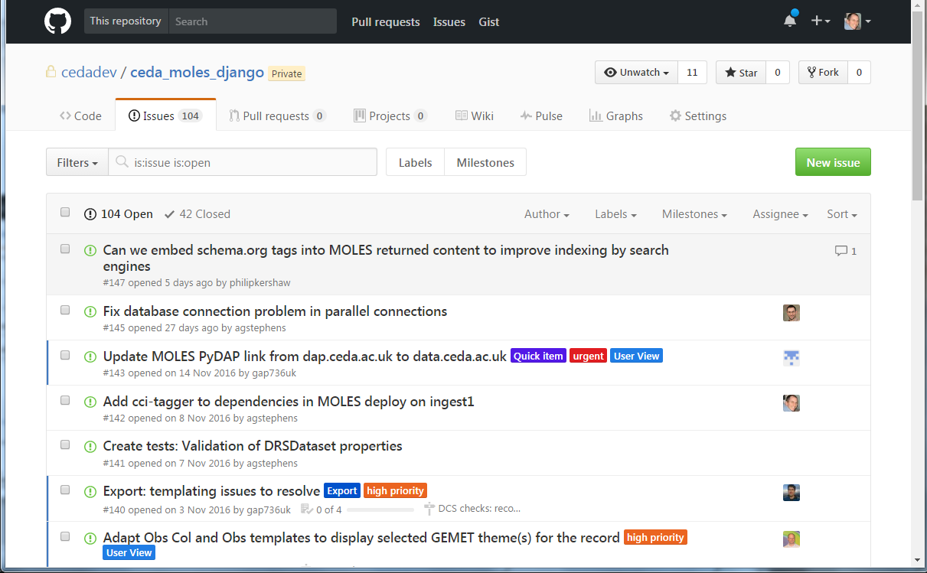
GitHub: Issue tracking
Notes:
You can manage all you bugs, problems and improvement plans as GitHub Issues - label them and even assign them to others in your team.

Slide 14
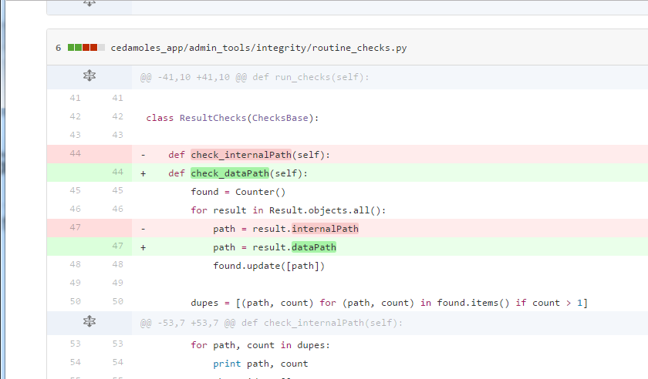
GitHub: history and change
Notes:
All changes made to the repository are stored in the history. At any point you can revert back (or across to other branches). Here we see an annotated difference between two versions in the history of the code. You can do this for individual files or the entire repository.

Slide 15
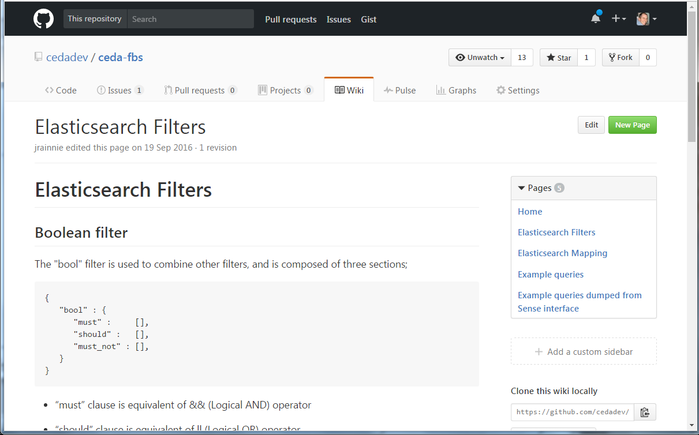
GitHub: wikis
Notes:
And you can document your code on the free wiki built in to each GitHub repo. And there are hundreds of other features and integrations with other tools that make code management easier.

Slide 16
GitHub Code-Sharing Example
STFC CEDA Firewall
GitHub
Private GIT Repository
Push/Pull
Public CEDA Projects: COWS WPS
Private CEDA Project:
COWS WPS
Public UoR Projects: COWS WPS
Fork
Pull-
Request
Push/
Pull
UoR Firewall
Private GIT Repository
Private UoR Project: COWS WPS
Notes:
This slide shows how GitHub provides a public collaborative set of Git repositories and tools through which organisations can interact.
In this example STFC CEDA has its own internal Git repository.
It can push/pull to the remove (public) copy of the repository on GitHub.
Another organisation, University of X, can have their own local (private) version and interact in the same way with the GitHub repository.
GitHub has extra tools, such as “forking” and “pull-requests” to allow useful tracking and interactions between the different versions.

Slide 17
Let's get started with GitHub
Anyone can get a free GitHub account - you'll only need to pay if you want private repos
We are going to learn Git and GitHub by using them throughout this course.
Let's get started… ☺

Slide 18
Create a GitHub account
Go to: https://github.com and sign up:

Slide 19
Authentication
You can use either a username/password or SSH key authentication. The latter is more secure but many folks use username/password.
For this course we will use username/password for simplicity.

Slide 20
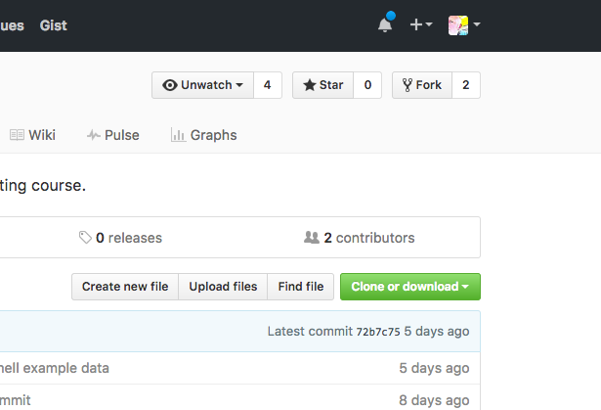
Fork
Find ncas-isc repository
Click on fork

Slide 21
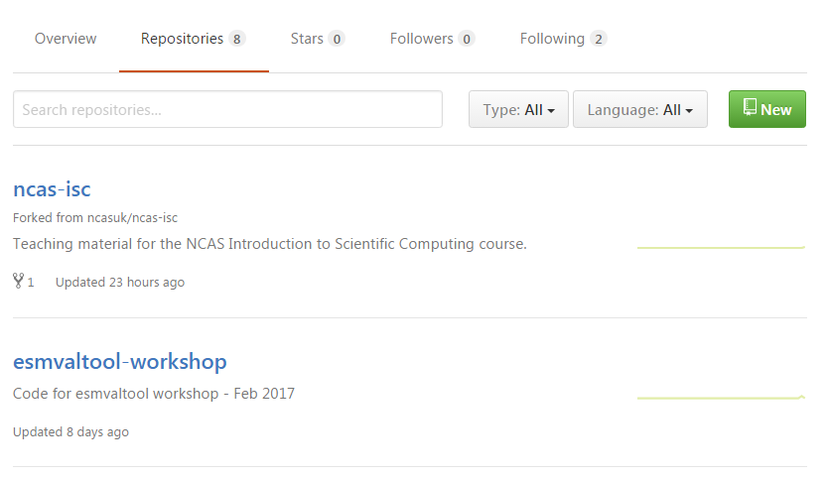
Create a repository (1)
Navigate to "Repositories" and click "New".

Slide 22
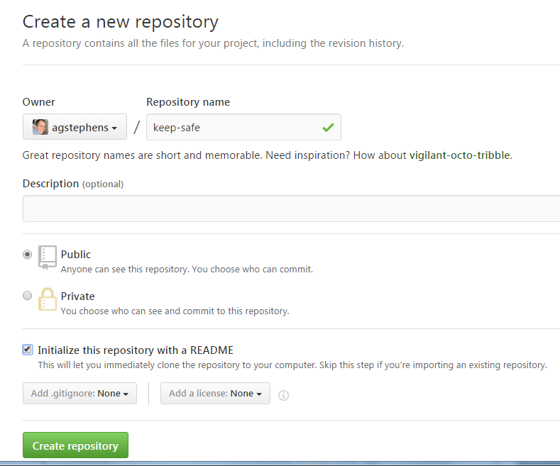
Create a repository (2): "keep-safe"
Select the basic details:
Call it "keep-safe"
Make it public
Tick "Initialize… …with a README"
Click "Create repository"

Slide 23
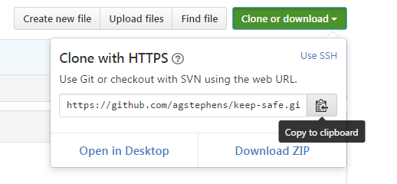
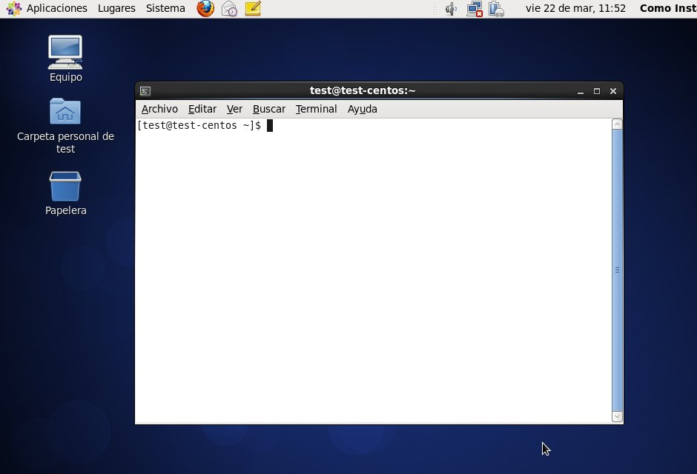
Copy the clone link
Click "Clone or download " and copy the link.
Go to your Linux Terminal.

Slide 24
Copy the clone link
Make sure you are in your home directory:
Write the git clone command and add the URL to the repository (which is different for each user):
$ cd $HOME
$ git clone https://agstephens@github.com/agstephens/keep-safe

Slide 25
Add a file to your local repo
1. Enter the repository directory:
$ cd keep-safe
2. Create a new file:
$ echo "hello world" > hello.txt
3. Tell Git about the file:
$ git add hello.txt
4. Commit the file to the local Git repository:
$ git commit -m "added hello"
5. Push any updates to the remote GitHub repo:
$ $ git push

Slide 26
So, what just happened?
We cloned the remote repository to our file system.
Now there are two identical copies of one repo.
We created a new text file.
We added and committed that new file to the local version of the repo.
We used push to update the remote repo.
GitHub Local
Clone (& pull)
Change
Add/ Commit
Push

Slide 27
Let's look on GitHub
And we can see the change has been made on GitHub…

Slide 28
Working plan for the week

Slide 29
Use Git/GitHub all week
This stuff is hard to learn - we know that from experience.
A presentation is quickly forgotten.
So, we propose that you use Git/GitHub for every exercise.

Slide 30
How will it work?
Create a new repository using the fork function within GitHub.
This means "take an existing repository and copy it into my GitHub workspace".
This repository contains all the course content.
In the first exercise you will then create a "mywork" directory to store your working files.
Throughout the course you will commit these (locally) and push them (remotely) to practice Git.

Slide 31
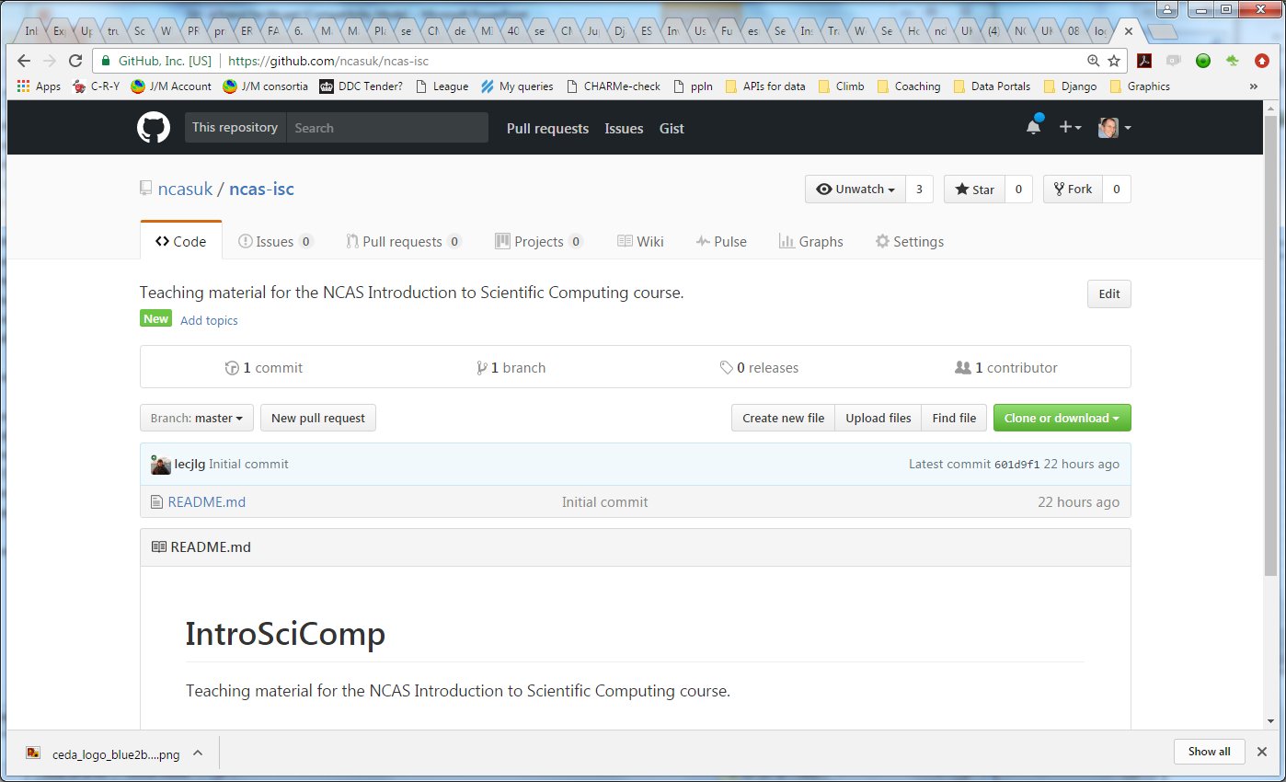
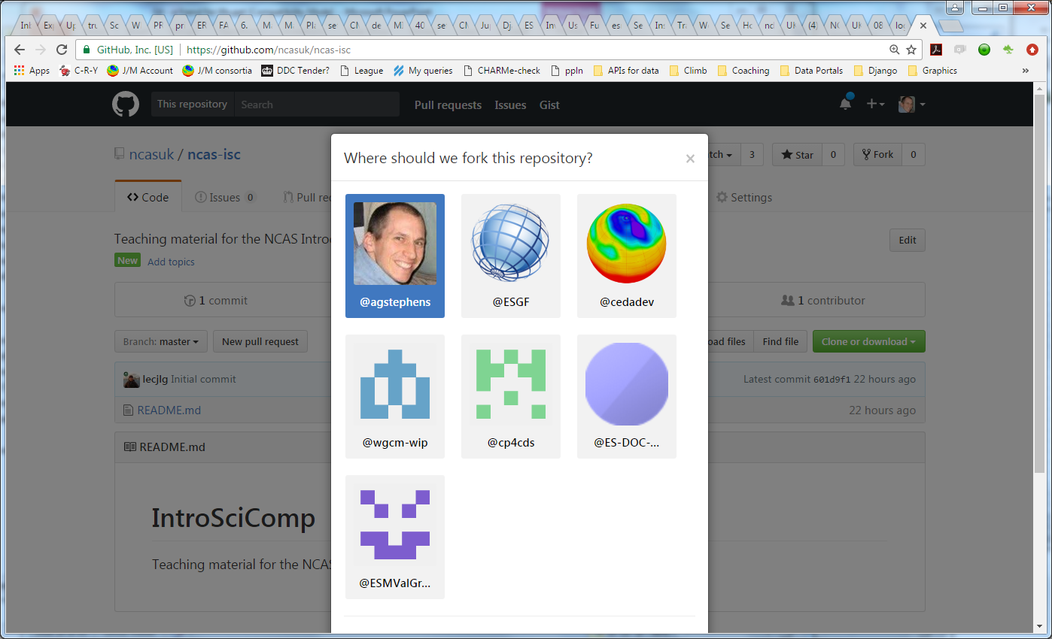
Fork the "ncas-isc" repository
Go to the "ncas-isc" repository:
https://github.com/ncasuk/ncas-isc
Click on the big "Fork" button and select your own your own GitHub space for the fork to be created in.

Slide 32
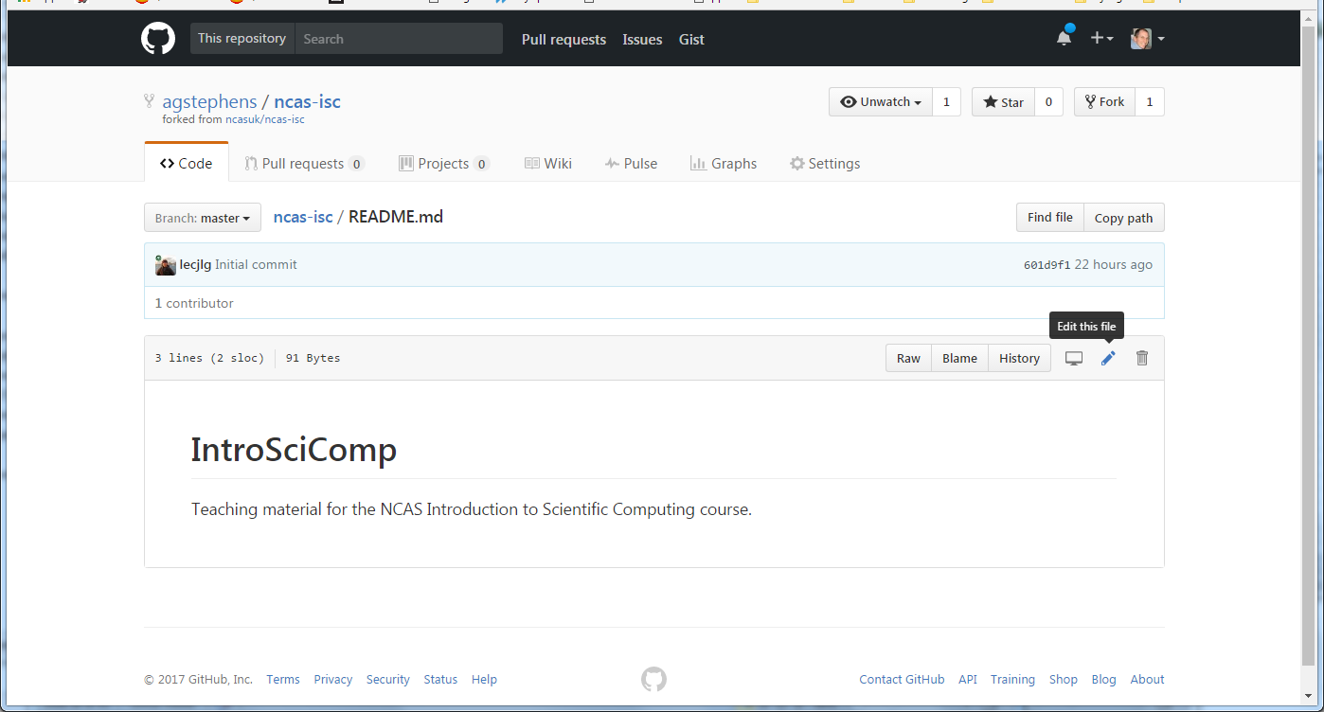
Let's edit the README file
You could write something in it like:
# Exercises from the Intro to Sci Comp course
This repository is where I put my workings for the ISC course.

Slide 33
Clone the repo locally
Now we have a remote version of the repo on GitHub…but we want to get a local copy. Let's clone it. Inside your Linux terminal, do:
$ cd $HOME
$ git clone https://<GITHUB_ID>@github.com/<GITHUB_ID>/ncas-isc
Replace "<GITHUB_ID>" with your own GitHub ID in the above URL.

Slide 34
OK, we are ready ☺
When you begin your first exercise:
Enter the repository directory:
$ cd $HOME/ncas-isc/
2. Create a working directory to store your exercises:
$ mkdir mywork
3. Add a README to the directory:
$ echo "My exercises" > mywork/README.txt
Notes:
To create a Git repository, go to a directory and type:
git init

Slide 35
And get your changes into Git
Add the README to your local repo and commit the change:
$ git add mywork/README.txt
$ git commit -m "Added a simple README"
2. Push your changes to the remote GitHub repository:
$ git push
Notes:
To create a Git repository, go to a directory and type:
git init

Slide 36
Let's enter "mywork/" and work there
Enter the directory:
$ cd mywork/
2. Create your first exercise script:
$ gedit ???? linux1.sh
3. Make your local repo aware of the file: $ git add linux1.sh
4. Commit it to the local repo:
$ git commit
Notes:
To create a Git repository, go to a directory and type:
git init

Slide 37
Let's enter "mywork/" and work there
Enter the directory:
$ cd mywork/
2. Create your first exercise script:
$ gedit ???? linux1.sh
3. Make your local repo aware of the file: $ git add linux1.sh
4. Commit it to the local repo:
$ git commit
Notes:
To create a Git repository, go to a directory and type:
git init

Slide 38
Whenever you want to push to GitHub
$ git push
…and your work is safely stored somewhere on the cloud!
Notes:
You can tell Git to monitor files (that you intend to commit) by adding them to the “staging area”.
See next slide for what the staging area is...

Slide 39
Why "add" and then "commit"?
Need explanation here of staging area…

Slide 40
What is the “staging area”?
The staging area is where you put the changes you intend to commit:
Stage all your intended changes
When ready and happy with them: commit
“Isn’t that more work?” you say...
YES: but you can package up each commit exactly as you want it.
Notes:
Talk through the slide.

Slide 41
Committing
$ git commit -m “Fixed typo in line 2”
OR, with the “add” process implicit in the commit (i.e. ignore the staging phase):
$ git commit -a -m “Fixed typo in line 2”
Notes:
When you want to commit: you are committing everything in the current staging area (that you have “added”).
You can include a comment with “-m” and even incorporate the “add” stage with “-a”.

Slide 42
Other tools in the Git ecosystem
Notes:
There are loads of great free tools to work with SVN and GIT. Here are just a few examples...

Slide 43
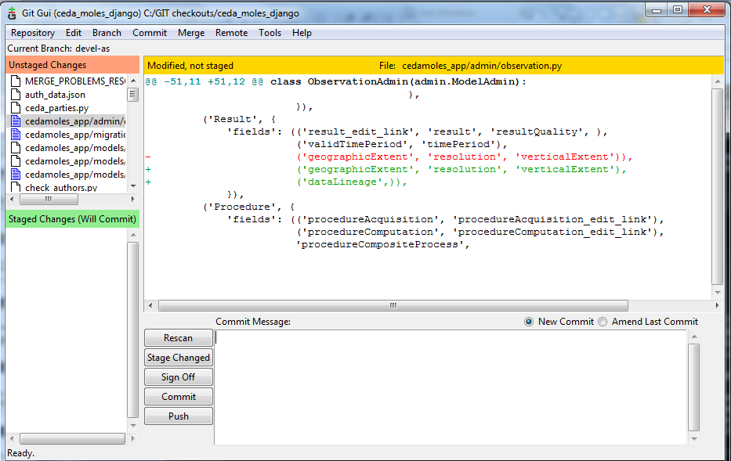
git gui
Full set of GUIs for interacting with local and remote repos.
Notes:
The Git gui provides a user interface to look at your local repository, files, changes, conflicts etc.

Slide 44
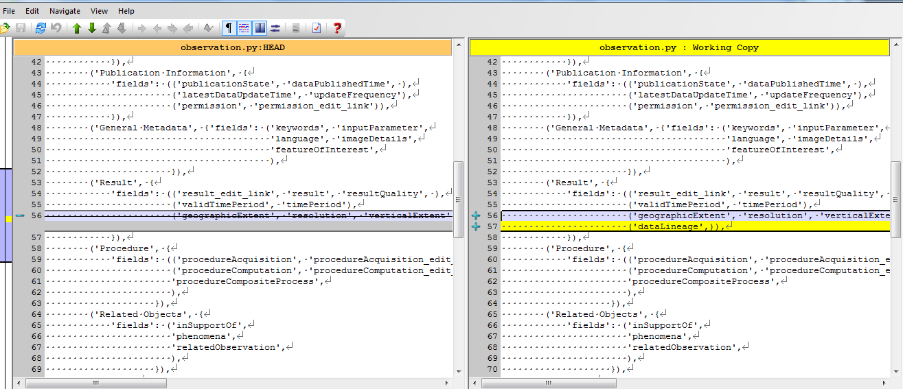
TortoiseGIT (for Windows)
Provides GUIs for adding/committing/changing - including a side-by-side diff…
Notes:
TortoiseGIT is a free GUI that works on linux and Windows. Here it is showing a diff between two different versions of a file.

Slide 45
The NCAS GitHub organisation
An NCAS GitHub organisation has been set up.
This allows repositories to be set up that where users could share code when it has become a more formal collaboration.
If you want to become part of the NCAS GitHub please contact Ag, James or Dan and send them your GitHub account ID.

Slide 46
The why - one more time
Using version control will save you time – No more accidentally deleting your workspace, or working on the wrong version of a file.
It will make you a better programmer – It encourages good working practices: such as documenting change.
It will help you collaborate more effectively – Others can access tagged releases of your code.
It will boost your scientific integrity – Helping you document your work; aiding reproducibility.
It will make you feel safe – No more waking up at 3 a.m. wondering if you backed up your work!
Notes:
This slide is intentionally evangelical! Talk through it.

Slide 47
Further information
Git documentation:
http://git-scm.com/documentation
Nice Git reference:
http://gitref.org/
GitHub:
http://github.com/

Slide 48
Acknowledgements
We would like to Acknowledge the following authors for some of the content presented here:
“Introduction to GIT”. Lukas Fittl (http://fittl.com).
“Git and GitHub”. Darren Oakley.

